Slide 1
Current Trends in Speech Accent Recognition
Louis Chuo & Henry An

Slide 2
Accent Bias in Speech Recognition Software
Our initial task is to determine how accent bias is affecting speech recognition
We will first research on what is an accent bias and how it affects accuracy
We then take a look at current commercial ASRs and see if they exhibit this bias
Then we look at research on current solutions being developed for this problem

Slide 3
Research on determining accent bias and how it affects ASR accuracy
Most common measurement is Word Error Rate (WER)
Modern Speech recognition software uses machine learning
There is a bias resulting from the specific dialects or accents used in training, for different dialects the average WER is different
More commonly spoken dialects are more commonly sampled; ASR systems are biased to them
However this is not the only factor affecting bias

Slide 4
Commercial ASR accuracy
Research on Black vs White American english on widely used ASRs like ones developed by Microsoft and Google yielded a 0.35 WER on blacks vs 0.19 for whites on average
Shows that current commercial ASRs are biased to white american english
There are currently no standardised dataset for accented speech
Closest is Mozilla’s voice corpus
Due to the nature of how the data was collected, it is saturated with american, british and indian english.

Slide 5
Recent Research to solve this issue
Use linguistic knowledge of common sound changes to aid in ASR accuracy
Use a multi-task model to translate speech and classify it’s accent
Combine this with another model that learns accent embeddings, which can be used as auxiliary inputs on the first model
Research shows definite improvement using this model, but there are a lot of overlaps on accents that can make “unseen”(i.e. not explicitly used to train the models) accents still fairly inaccurate.

Slide 6
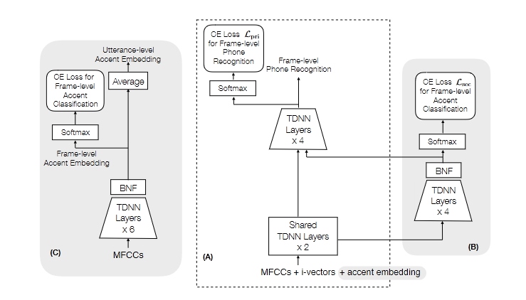

Slide 7
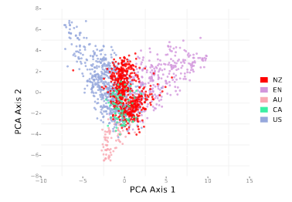
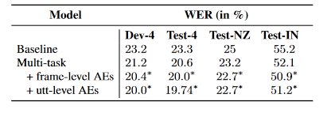

Slide 8
Research Questions
Investigate if we can improve an ASR model to be more accurate on the NZ accent using linguistic analysis to provide bias adjustment.

